Slide 1
The Six Steps and Web Analysis
Web Design and Digital Self Awareness

Slide 2
What Is Art?

Slide 3

What Is Art?
Scott McCloud
Comic Book Theorist
Understanding Comics (1993)

Slide 4
What Is Art?
“Art, as I see it, is any human activity which doesn’t grow out of either of our species’ two basic instincts: survival and reproduction.”
      –Scott McCloud (1993)

Slide 5
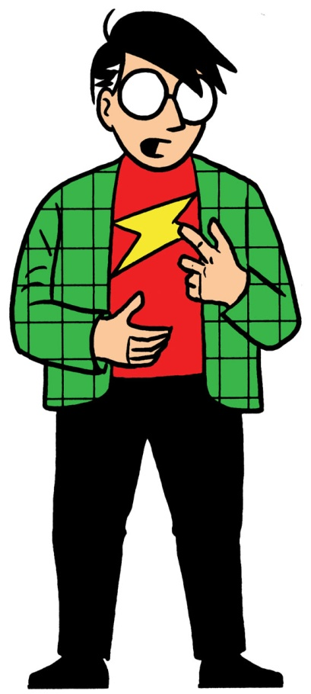
The Six Steps
Of Art Making

Slide 6
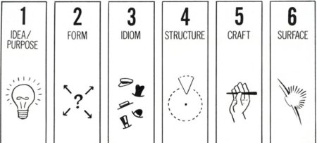
Six Steps Of Making Art
Idea/Purpose
Form
Idiom/Genre
Structure
Craft
Surface

Slide 7
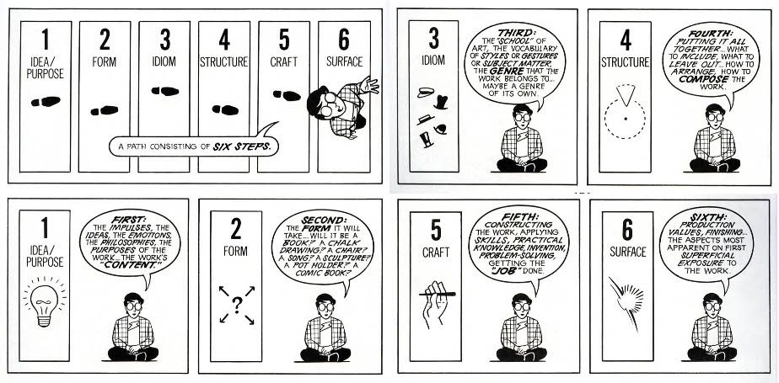
Six Steps To Making Art
1) Idea/Purpose
  The Work’s “Content”
  The Work’s Philosophy
  Why was this piece created?
  Why am I creating this piece?

Slide 8
Six Steps To Making Art
2) Form
  How the idea will be experienced.
  The type of art
  How will the piece be presented?

Slide 9
Six Steps To Making Art
3) Idiom/Genre
  The vocabulary you use to better describe the form.
  Think Movies!
  How can I best describe this project?

Slide 10
Six Steps To Making Art
4) Structure
  A Mental Blueprint.
  Thinking how the final product should look/sound/feel/etc.
  How do I want this to look upon completion?

Slide 11
Six Steps To Making Art
5) Craft
  The skills required to create the piece.
  Honing/Learning in order to create.
  What do I need to learn before I can create
  this?

Slide 12
Six Steps To Making Art
6) Surface
  The final piece
  What is everyone seeing?
  How many of the other five steps can be seen in the project’s final form?

Slide 13
Six Steps To Making Art
Idea/Purpose
Form
Idiom/Genre
Structure
Craft
Surface

Slide 14
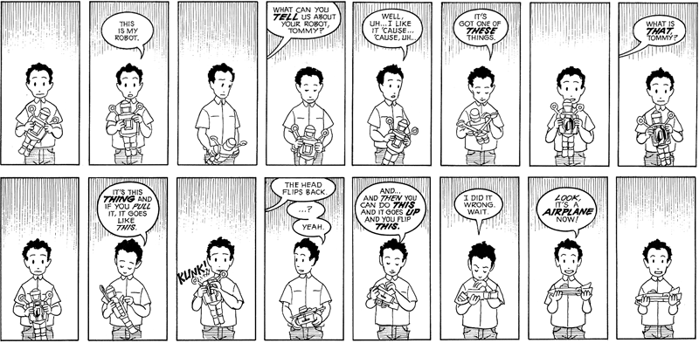
Why Are The Six Steps Important?

Slide 15
Why Are The Six Steps Important?
You Better Understand The Artist’s Process
You Better Understand Your Own Process
Easier To Learn From Previous Work
The Six Steps Can Be Applied To ANYTHING

Slide 16
The Six Steps In Action

Slide 17
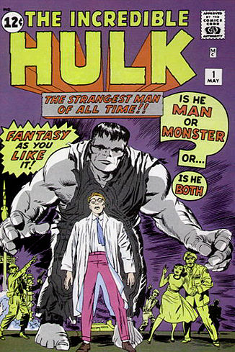
The Incredible Hulk (May 1962)

Slide 18
The Incredible Hulk (May 1962)
Idea: Create a character to discuss Stan Lee’s fluctuating emotions
Form: Comic Book Story
Idiom: Horror (later superhero) story
Structure:
  Stan Lee: A Marvel Method script that explains the hulk’s unpredictable nature
  Jack Kirby: Cognitive page layouts and character design ideas
Craft: Poignant writing skill sets and expressive anatomy drawing abilities
Surface: The Comic

Slide 19
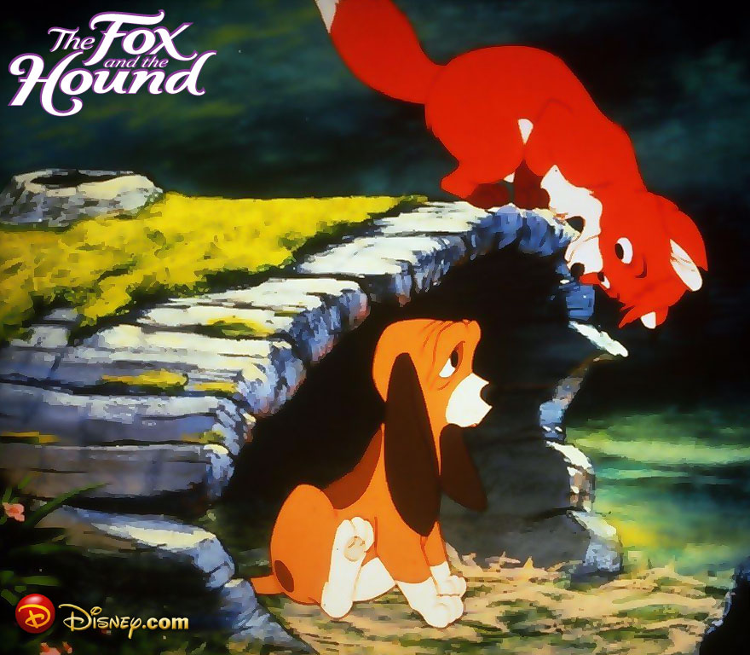
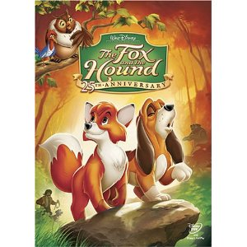
The Fox And The Hound

Slide 20
The Fox And The Hound (1981)
Idea: Discuss the tension between growing up, friendship, and your upbringing
Form: Motion Picture
Idiom: Animation/Kids Movie/Coming Of Age Story
Structure: Plan for narrative flow and visual representation
Craft: Scriptwriting skills, animation knowledge, ability to direct large groups of individuals
Surface: The Final Film

Slide 21
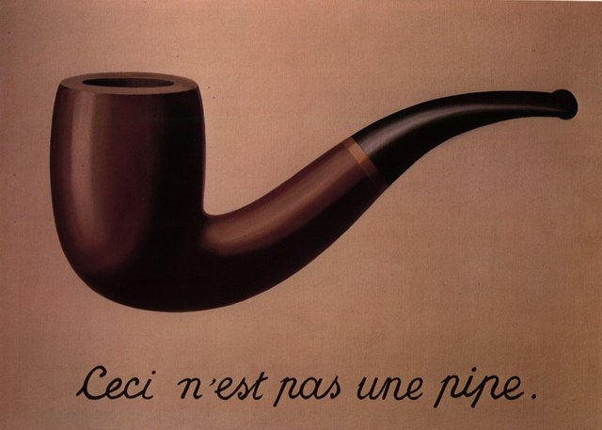
The Treachery Of Images by Rene Magritte (1928-1929)

Slide 22
The Treachery Of Images
By Rene Magritte (1928-1929)
Inscription says “This Is Not A Pipe”

Slide 23
The Treachery Of Images
By Rene Magritte (1928-1929)
Idea: Develop a piece that talks about the translation problem with reproductive art forms
Form: Painting
Idiom: Still Life/Photo Realistic/Art Commentary
Structure: Mental layout of the piece. Determining the grade of minimalism
Craft: Fine arts painting skills
Surface: The Final Painting

Slide 24
Words As Art
“There are many causes that I am prepared to die for but no causes that I am prepared to kill for.”
  Mohandas Karamchand Gandhi
    Quote from his autobiography The Story Of My Experiments With Truth

Slide 25
Words As Art
“There are many causes that I am prepared to die for but no causes that I am prepared to kill for.”
  Idea: Express a view that violence and death does not solve any problems or better any cause
  Form: The Written Word
  Idiom: Autobiographical Quote
  Structure: An idea of how the statement would best be conveyed
  Craft: Honing linguistic capabilities
  Surface: The written quote

